Slide 1
Course Title - Web System Engineering
Topic Title - Create React App / Installation
Presenter’s Name - M ArunKumar
Presenter’s ID - IARE11151
Department Name - CSE ( Artificial Intelligence, and Machine Learning )
Lecture Number - #
Presentation Date - ##/03/2025

Slide 2
Getting Started
Create React App is an officially supported way to create single-page React applications. It offers a modern build setup with no configuration.
npx create-react-app my-app
cd my-app
npm start
installed Globally : npm install -g create-react-app
uninstall the package using npm uninstall -g create-react-app
Then open http://localhost:3000/ to see your app.

Slide 3
Folder Structure
my-app
├── README.md
├── node_modules
├── package.json
├── .gitignore
├── public
│ ├── favicon.ico
│ ├── index.html
│ ├── logo192.png
│ ├── logo512.png
│ ├── manifest.json
│ └── robots.txt
└── src
├── App.css
├── App.js
├── App.test.js
├── index.css
├── index.js
├── logo.svg
├── serviceWorker.js
└── setupTests.js
Running any of these commands will create a directory called my-app inside the current folder. Inside that directory, it will generate the initial project structure and install the transitive dependencies:

Slide 4
Mandetory Folders and Files
For the project to build, these files must exist with exact filenames:
public/index.html is the page template;
src/index.js is the JavaScript entry point.
You can delete or rename the other files.
You may create subdirectories inside src. For faster rebuilds, only files inside src are processed by webpack. You need to put any JS and CSS files inside src, otherwise webpack won’t see them.
Only files inside public can be used from public/index.html. Read instructions below for using assets from JavaScript and HTML.

Slide 5
Available Scripts
In the project directory, you can run:
npm start​
Runs the app in the development mode. Open http://localhost:3000 to view it in the browser.
The page will reload if you make edits. You will also see any lint errors in the console.
npm test​ - Launches the test runner in the interactive watch mode. See the section about running tests for more information.
npm run build​
Builds the app for production to the build folder. It correctly bundles React in production mode and optimizes the build for the best performance.

Slide 6
npm run eject​
Note: this is a one-way operation. Once you eject, you can’t go back!
If you aren’t satisfied with the build tool and configuration choices, you can eject at any time. This command will remove the single build dependency from your project.

Slide 7
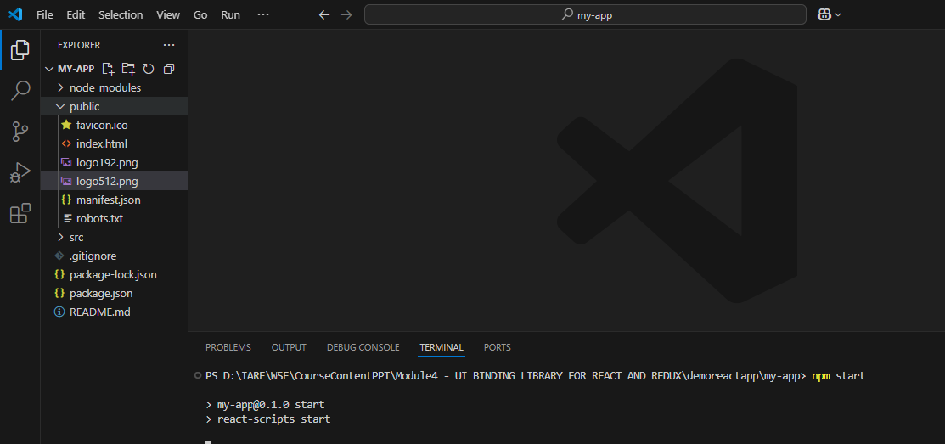

Slide 8
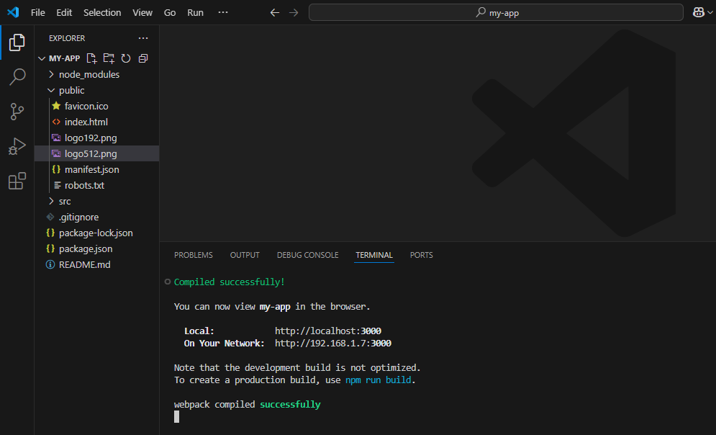

Slide 9
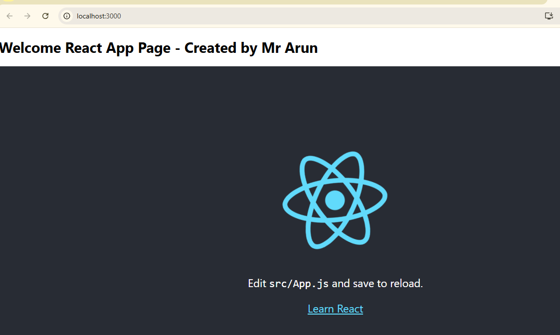

Slide 10
React Basics - Part 01 -dependencies & Script
"dependencies": {
"@testing-library/dom": "^10.4.0",
"@testing-library/jest-dom": "^6.6.3",
"@testing-library/react": "^16.2.0",
"@testing-library/user-event": "^13.5.0",
"husky": "^9.1.7",
"lint-staged": "^15.4.3",
"prettier": "^3.5.3",
"react": "^19.0.0",
"react-dom": "^19.0.0",
"react-scripts": "5.0.1",
"web-vitals": "^2.1.4"
},
"scripts": {
"start": "react-scripts start",
"build": "react-scripts build",
"test": "react-scripts test",
"eject": "react-scripts eject"
},

Slide 11
React Basics - Part 01 - src / Index.js - Entry point for all react apps
importReactfrom'react';
importReactDOMfrom'react-dom/client';
import'./index.css';
importAppfrom'./App';
importreportWebVitalsfrom'./reportWebVitals';
constroot=ReactDOM.createRoot(document.getElementById('root'));
root.render(
<React.StrictMode>
<App/>
</React.StrictMode>
);
// If you want to start measuring performance in your app, pass a function
// to log results (for example: reportWebVitals(console.log))
// or send to an analytics endpoint. Learn more: https://bit.ly/CRA-vitals
reportWebVitals();

Slide 12
Thank You

